Slide 1
Electrons and Molecular Forces
Chemistry 30 – Ms. Hayduk

Slide 2
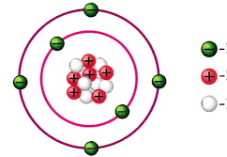
Atomic Structure
Atomic Number
Number of _____________________________
Defines the element
Used to organize the periodic table

Slide 3
Bohr Model of the Atom
Electrons can only move in specific energy levels (n)
Larger values of n = ___________________ _______________
Each energy level = an ______________ (circular path around nucleus)

Slide 4
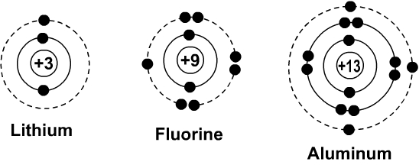
Bohr Models
Energy Level (Orbit) | 1 | 2 | 3 | 4
Number of Electrons

Slide 5
Quantum Mechanical Model
Electrons exist at _____________________ energy levels (certain values with none “in-between”)
Impossible to determine electron location and velocity (_________________________ __________________________), because observing it changes how it is moving or where it is

Slide 6
Quantum Mechanical Model
Electrons don’t follow specific orbits
3D cloud around nucleus (atomic _________________) describes probable location
Electrons have spin, clockwise or counter-, so only _________ can be in an orbital

Slide 7
Quantum Numbers
Size | n
Shape | l
Orientation | m_{l}
Spin | m_{s}

Slide 8
Orbital Shapes

Slide 9
Electron Configuration
Explains arrangement of atoms in lowest possible energy state (___________________________)
Can be in atoms or ions

Slide 10
Electron Configuration

Slide 11
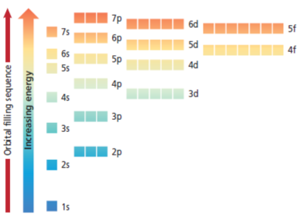
Aufbau Principle
electrons occupy the __________________ energy orbitals first

Slide 12
Pauli Exclusion Principle
Only two electrons, with opposite spins, can occupy an orbital

Slide 13
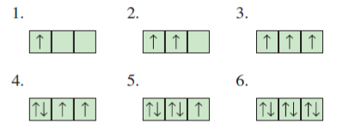
**Hund’s Rule
Single electrons with same spin must occupy each equal energy orbital before a second electron can be in an orbital
Notes:
Analogy: strangers getting on a bus

Slide 14
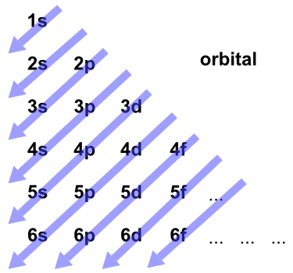
Orbitals

Slide 15
Examples: Electron Configuration
H B
Na Cl
Ag Sn

Slide 16
Noble Gas Configuration
Write the noble gas from the _______________________________ in square brackets, then continue electron configuration from that point
Example:
Mg (1s²2s²2p⁶3s²) becomes:

Slide 17
Examples: Noble Gas Config.
Ti
Cd
Cl

Slide 18
Ions
Metals lose electrons from highest energy levels first (n), then largest l (f, d, p, s)
Non-metals will gain electrons from in lowest energy levels first (lowest n with space available)
Determine valence electrons by:

Slide 19
Example: Valence Electrons
How many valence electrons does Br have?
How many valence electrons does Ag have? (This is more challenging!)

Slide 20
Valence Electrons
Electrons in the outermost orbitals – available to bond
e.g. Oxygen [He]2s²2p⁴ has ______
Lewis Structure: shows symbol and valence electrons

Slide 21
Examples: Lewis Diagrams
F Ca
Pb Nd

Slide 22
Ion Formation
Ion: an atom that becomes charged by gaining or losing electrons to empty or fill an orbital

Slide 23
Ionic Bonds
Formed when two or more ions with opposite charges are attracted together to form a compound
Contain a metal (_______________) and one or more non-metals (______________)
Overall charge is __________

Slide 24
Example: Ionic Bonds
Na and Cl
Mg and N
Notes:
Lewis diagrams for atoms, Lewis diagrams for ions,

Slide 25
Metallic Bonds
Metals form lattices where valence electrons move freely between atoms

Slide 26
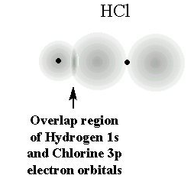
Covalent Bonds
AKA molecular bonds
Formed between non-metals, outer orbitals overlap to share electrons between atoms

Slide 27
Lewis Structures
Used to show 2D bonding shape of covalent molecules
Bonds are lines (single ―, double =, triple ≡), electron pairs are two dots

Slide 28
Rules
Only for non-metals
Atoms want to fill their orbitals
Often _____________ valence electrons, with many exceptions
Can be more for d and f orbitals
Hydrogen always has only _________ single bond, ______ lone pairs
Central atom has the most unpaired electrons (often carbon), is least electronegative

Slide 29
Steps
Count # valence electrons in all atoms
Draw symbol of central atom(s), with any electron pairs
Draw single bonds between outer and central atom(s). Determine available electrons left (2 ×# single bonds)
Draw lone pairs in available spaces to fill orbitals
Too many electrons? Erase two lone pairs and add a bond (repeat as needed)

Slide 30
Examples: Lewis Structures
F₂
NH₃
HCN
SF₆

Slide 31
General Rule
Periodic trends depend on the attraction between __________________ charges (protons and electrons) and the repulsion of _______________ charges
Larger positive/negative charge difference __________________ attraction
Distance __________________ the attraction between opposite charges

Slide 32
Analogy
The nucleus is a magnet.
Electrons are attracted to the magnet.

Slide 33
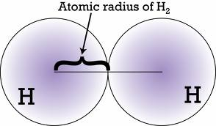
Atomic Radius
______________________________________ between adjacent nuclei of the same element

Slide 34
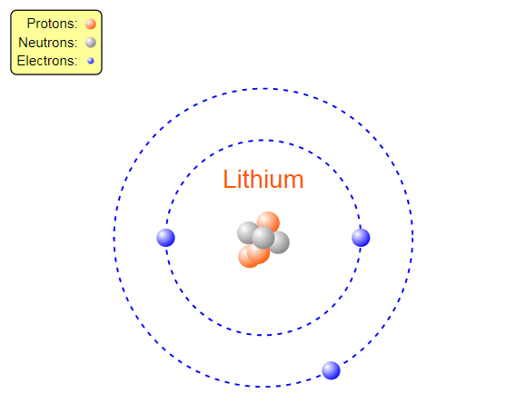
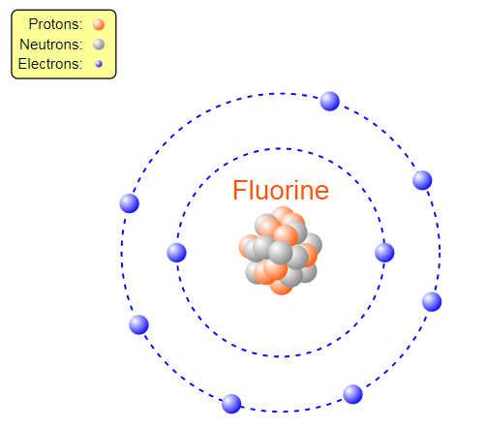
Atomic Radius
_____ across a period (larger nucleus, same number of energy levels)

Slide 35
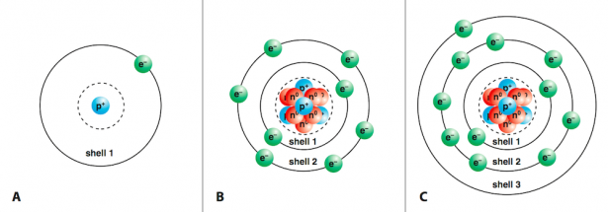
Atomic Radius
____ down a group (higher energy levels, electrons are further away, cannot be attracted as strongly)

Slide 36
Electronegativity
Ability of an atom to ___________________ ____________ in a chemical bond
0 – 4.0 Paulings (0 for noble gases)
______ electronegativity = atom “wants” to gain electrons, ______ = wants to give away
_____ across a period (larger nucleus pulls electrons in closer)
______ down a group (________________)

Slide 37
_________molecular Forces
Describes how bonds are formed __________________ a compound (chemical bonds) – how electrons move between the atoms
Strength depends on difference in ______________________________ between elements
Types:

Slide 38
Bond Polarity
Difference in electronegativity determines __________________ of a bond
Polarity:
Determines type of bond within a compound

Slide 39
Example: Bond Polarity
What is the electronegativity difference in a C-F bond?

Slide 40
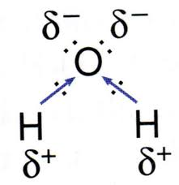
Dipoles
Dipole:
Formed when electrons are held closer to one atom in a bond than the other
Indicated by δ (delta) and the ^{charge}

Slide 41
Example: Dipoles
In a C-F bond, identify the dipoles.

Slide 42
Bonds and Electronegativity
Ionic: complete transfer of electrons, EN difference > _____
Covalent:
Non-Polar: equal sharing of electrons, EN < _____
Polar: unequal sharing, ____ <EN<____
EN is ________: ionic if a metal is involved, otherwise polar covalent

Slide 43
Example: Intramolecular Forces
What type of intramolecular force is present in each bond?
Ca-F C-H
N-N Na-Cl
C-O H-F

Slide 44
Ionic Compounds
Solid, brittle, poor conductors in the solid state
Regular crystal structure
Dissolve in ____________ substances only (like dissolves like) to form ___________________ (solutions that conduct electricity)
____________ melting point (as an example, sodium chloride melts at ________)

Slide 45
Non-Polar Compounds
Can be solid, liquid or gas, although many are gases
Often more flexible and soft
Dissolve in ________________ substances (like dissolves like)
_______ melting and boiling points (many below zero)

Slide 46
Polar Covalent Compounds
For solids, irregular crystal structure
Can be solid, liquid or gas
Can dissolve in polar substances and non-polar substances, (depending on structure) can form weak electrolytes (solutions that conduct electricity)
Moderate melting and boiling points – compare to water

Slide 47
VSEPR Models
Shows 3D shape of covalent molecules
Helps to determine properties of molecule and substance
Shape is based on one central atom (larger molecules can have multiple VSEPR shapes at different places)

Slide 48
Drawing VSEPR
Determine central atom
Draw Lewis diagram
Determine number of bonds and electron pairs (steric number) and number of lone pairs
Check VSEPR shape table to determine geometry

Slide 49
Examples: VSEPR
CH₄ XeF₄
NO₃ CO₂

Slide 50
Polarity and Geometry
Even if bonds are polar, the molecule overall may be non-polar
If bonds are polar, check _______________
Look “along” each bond – if the molecules is the same on both sides, it is symmetric

Slide 51
Symmetry Rules
If all “X”s are the same:
If “X”s are different or any other geometry, as long as _________ are polar, ___________________ is polar.

Slide 52
Polarity and Geometry
Steps:
Check polarity of ALL bonds with central atom
If all are non-polar, molecule is non-polar
Check molecular shape
If shape is symmetric, molecule is non-polar
Notes:
FLOW CHART THIS

Slide 53
Examples: Molecular Polarity
O₂ BrF₅
PF₅ H₂O

Slide 54
Intermolecular Forces
Intramolecular forces: describe attractive/repulsive forces within a molecular or compound (ionic or covalent)
Intermolecular forces:

Slide 55
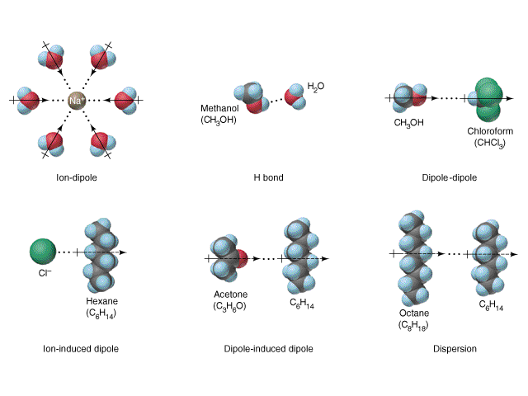

Slide 56
London Forces
Also called dispersion forces (Van der Waals forces)
Caused by ______________________________________ caused by electron movement in a molecule
Weak forces that exist for _________ molecules
Increases in strength with ___________________

Slide 57
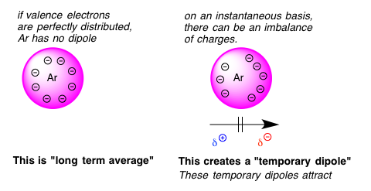
London Forces

Slide 58
Induced Dipoles
Attraction between a non-polar molecule and either a ion (ion-induced dipole) or a polar molecule (dipole-induced dipole)
Works similar to dispersion forces, but slightly stronger
Charge on polar molecule moves electrons in non-polar molecule, making partial, temporary charge

Slide 59
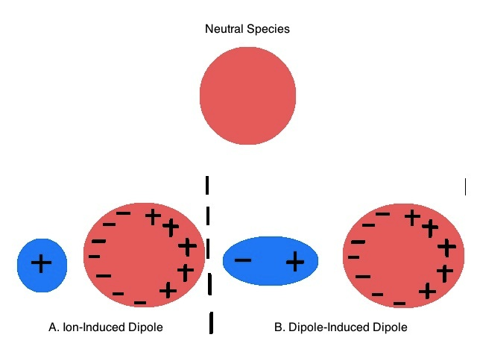
Induced Dipoles

Slide 60
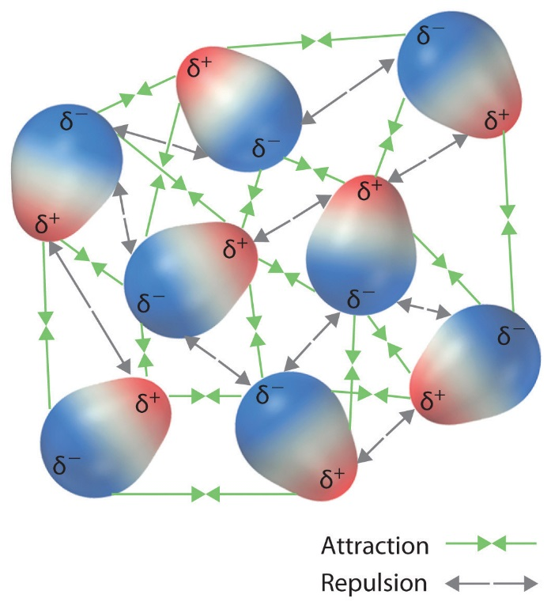
Dipole-Dipole Forces
Attractions between charged points on polar molecules (dipoles)

Slide 61
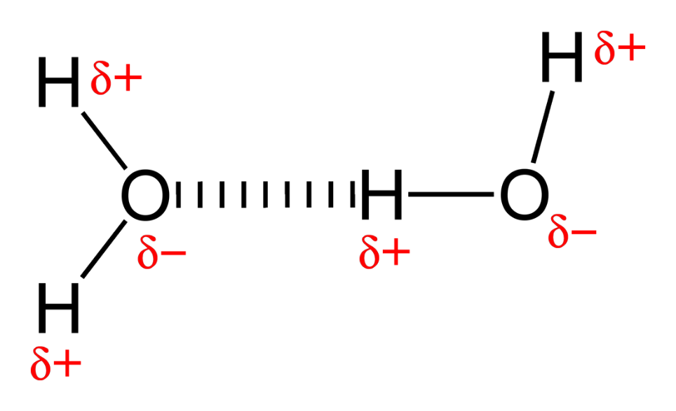
Hydrogen Bonding
Specific type of dipole-dipole force (___________________)
Occurs when ________________________ is directly bonded to H
Almost ionic in terms of EN difference

Slide 62
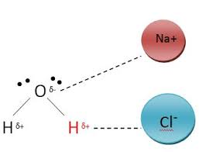
Ion-Dipole Forces
Attraction between a polar molecule and an ionic molecule
Very strong, due to large charge separation
Explains solubility of ionic compounds in water

Slide 63
IMFs for One Substance
Most
Least
All substances have London forces.
Polar substances have dipole-dipole forces, and some also have hydrogen bonding.

Slide 64
Strength of IMFs
Substances will often have more than one type of intermolecular force
When asked to identify IMFs for a substance, generally the _______________ one is the most informative

Slide 65
Other Intermolecular Forces
Ionic attraction, or lattice energy
Describes attraction between ions in a compound
Increases as ion charges increase (so +2 /-2 is stronger than +1/-1)
Covalent network
Occurs in covalent solids (e.g. diamond)
Very strong, harder to break than ionic attraction

Slide 66
Example 1: IMFs
What IMFs does water have?

Slide 67
Example 2: IMFs
What IMFs does CCl₄ have?

Slide 68
Example 3: IMFs
What intermolecular force causes sodium chloride to dissolve in water?

Slide 69
Effect of Intermolecular Forces
Melting and Boiling Points
___________________ with stronger forces
For substances with the same type of IMF, MP and BP will be ________________ with ________________ molar mass
Surface Tension
________________ with stronger forces

Slide 70
Example: Boiling Points
Which would have a higher boiling point of:
HF or HCl?
CO₂ or NH₃?

Slide 71
Example: Surface Tension
When a drop of water is placed on a surface, it holds it shape. What causes it to do this?

Slide 72
Effect of Intermolecular Forces
Vapour Pressure
Affects flammability, volatility
How easily a substance will ________________ (become a gas)
Vapour pressure is ________________ (less gas produced) with stronger IMFs
Density
________________ with stronger IMFs – molecules are held more tightly together

Slide 73
Example: Vapour Pressure
Which would evaporate first, water (H₂O) or methanol (CH₃OH)?

Slide 74
Example: Density
Explain why the density of the halogens increases down the family.

Slide 75
Effect of Intermolecular Forces
Solubility
“___________________________________”
Polar/ionic solutes dissolve in polar solvents, non-polar solutes dissolve in non-polar solvents
Polar molecules have a stronger attraction to other polar molecules than to non-polar molecules, so they do not interact

Slide 76
Effect of Intermolecular Forces

