Slide 1
Electrochemistry
Chemistry 30

Slide 2
Redox Reactions
Redox = oxidation and reduction
Originally, oxidation meant combination with oxygen (corrosion, combustion), but now means loss of electrons
Reduction originally meant refining metal ores to pure metals, causing a reduction in mass, but now means gain of electrons
In general, redox reactions occur when there is a transfer of electrons

Slide 3
Example: Redox
The single displacement reaction between copper and silver is:
Cu (s) + 2 AgNO₃ (aq) → 2 Ag (s) + Cu(NO₃)₂ (aq)
Write the total and net ionic equations.
Which metal is being oxidized?
Which metal is being reduced?

Slide 4
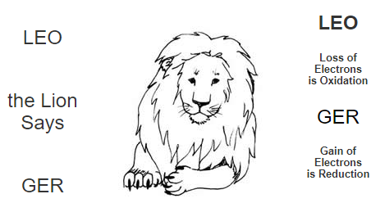
Trick for Redox

Slide 5
Oxidation States/Numbers
Positive/negative number for an atom or ion that reflects partial gain or loss of electrons
Rules in reference book
One oxidation number for EACH atom/ion, so must pay attention to subscripts, but coefficients (for balancing equation) do not matter

Slide 6
Example: Oxidation States
Determine the oxidation number for each element in the following compounds:
S₈
H⁺
SnO₂
CO₃²⁻
Al₂(SO₄)₃
Na₃Co(NO₂)₆

Slide 7
Identifying Redox Reactions
Oxidation numbers can be used to identify if a reaction is a redox reaction
If no elements change oxidation states between reactant and products, then no redox occurs

Slide 8
Example: Identifying Redox
Use oxidation numbers to determine if these are redox reactions.
3 Hg²⁺ (aq) + 2 Fe (s) → 3 Hg₂ (s) + 2 Fe³⁺ (aq)
NaCl (aq) + AgNO₃ (aq) → AgCl (s) + NaNO₃
2 As (s) + 3 Cl₂ (g) → 2 AsCl₃ (s)

Slide 9
Half-Reactions
Breaks a full reaction apart into reduction equation and oxidation equation
Example:
Zn (s) + 2 HCl (aq) → ZnCl₂ (aq) + H₂ (g)
becomes…
Zn (s) → Zn²⁺ (aq) + 2 e⁻
2 H⁺ (aq) + 2 e⁻ → H₂ (g)
Must be balanced by mass (atoms/ions) and charge

Slide 10
Example 1: Half-Reactions
Zn (s) + Pb(NO₃)₂ (aq) → Pb (s) + Zn(NO₃)₂ (aq)
Write net ionic equation. (What is the spectator ion?)
Write the half-reaction for zinc.
Write the half-reaction for lead.
Identify which element is being oxidized and which is being reduced.

Slide 11
Example 2: Half-Reactions
Write both half-reactions, and identify which element is being oxidized and which is being reduced.
SnO₂ (s) + C (s) → Sn (s) + CO₂ (g)

Slide 12
Acidic Conditions
Means there is excess H⁺ ions in the solution
To write:
Create the half-reactions as usual
Balance elements other than H and O
Add H₂O to balance out oxygen atoms (to the opposite side of the arrow)
Add H⁺ to balance out hydrogen in the water molecules
Add charges and put electrons on the proper side

Slide 13
Example: Acidic Conditions
Write the half-reaction for dichromate, Cr₂O₇²⁻, forming chromium(III) ions in acidic solution.

Slide 14
Basic Conditions
Means there is an excess of hydroxide ions
As with other base calculations, more steps here
To write:
Steps are the same as for acidic conditions, with one additional step:
Add OH⁻ ions to both sides to balance all H⁺
Cannot end up with H⁺ in your end reaction (bases have OH⁻, not H⁺)

Slide 15
Example: Basic Conditions
Write the half-reaction for solid silver forming silver oxide in basic solution.

Slide 16
Balancing with Half-Reactions
Break reaction into two half-reactions; remove spectator ions
Balance each half-reaction separately, by mass and charge
Compare both half-reactions so total number of e⁻ is equal for both (multiply each half-reaction by whole number)
Add half-reactions together and add back spectator ions

Slide 17
Example 1: Balancing with HR
Mg (s) + Cl₂ (g) → MgCl₂ (s)

Slide 18
Example 2: Balancing with HR
Cu (s) + AgNO₃ (aq) → Cu(NO₃)₂ (aq) + Ag (s)

Slide 19
Example 3: Balancing with HR
MnO₄⁻ + Fe²⁺ + H⁺ → Mn²⁺ + Fe³⁺ + H₂O

Slide 20
Acidic Solutions
Create half-reactions as usual, using steps for half-reactions in acidic conditions
Balance electrons in both half-reactions, then add together
Cancel common terms

Slide 21
Example: Acidic Solutions
Balance the following reaction in acidic conditions:
Cr₂O₇²⁻ (aq) + HNO₂ (aq) → Cr³⁺ (aq) + NO₃⁻ (aq)

Slide 22
Basic Solutions
Create half-reactions as usual, using steps for half-reactions in basic conditions
Balance electrons in both half-reactions, then add together
OH⁻ and H⁺ ions (on the same side) combine to form water
Cancel common terms

Slide 23
Example: Basic Solutions
Balance the following reaction in basic conditions:
Cu (s) + HNO₃ (aq) → Cu²⁺ (aq) + NO (g)

Slide 24
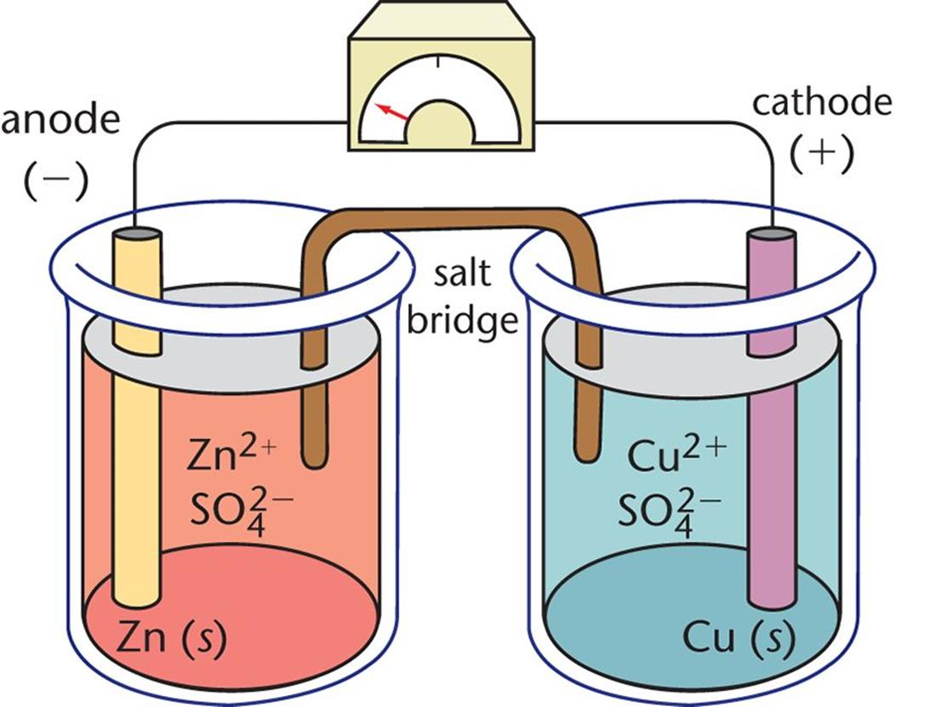
Voltaic Cells
AKA galvanic cells
Half-reactions are split into two separate cells, connected by a conducting material and a salt bridge.
Notes:
https://www.youtube.com/watch?v=7b34XYgADlM

Slide 25
Cell Notation
anode | electrolyte || electrolyte | cathode
Anode is the site of oxidation (An Ox)
Cathode is the site of reduction (Red Cat)

Slide 26
Standard Reduction Potential
Indicates the tendency of an element to gain electrons
In electrochemical cells, identifies which element will be oxidized and which will be reduced
Measured in volts, relative to reduction potential of hydrogen (0.0 V), at standard conditions (25°C, 1 atm, 1 mol/L solutions)

Slide 27
Standard Reduction Potential
The half-cell higher up the list (more positive) will be reduced; other will be oxidized

Slide 28
Example: Voltaic Cells
For the two half-reactions:
Zn (s) → Zn²⁺ (aq) + 2 e⁻
Ag (s) → Ag⁺ (aq) + e⁻
Write the half-reactions in cell notation.
Draw a diagram of the electrochemical cell, assuming is it spontaneous. Label the electrodes, electrolytes, direction of electron flow and direction of ion movement.
What would be a suitable substance for the salt bridge for this reaction?

Slide 29
Cell Potential
$$E_{cell}^{\text{°}}=E_{reduction}^{\text{°}}−E_{oxidation}^{\text{°}}$$
For a voltaic cell, E_{cell} will be positive, meaning the reaction will occur spontaneously

Slide 30
Example 1: Cell Potential
Determine the cell potential for the overall cell reaction:
2 Al³⁺ (aq) + 3 Cu (s) → 3 Cu²⁺ (aq) + 2 Al (s)

Slide 31
Example 2: Cell Potential
Determine the cell potential for the overall cell reaction:
Cd (s) + 2 NO₃⁻ (aq) + 4 H⁺ (aq) →
Cd²⁺ (aq) + 2 NO₂ (g) + 2 H₂O (l)

Slide 32
Example 3: Cell Potential
An electrochemical cell is constructed with iron (making Fe³⁺ ions) and calcium.
Determine the anode and cathode, if the cell is spontaneous.
Write the cell notation.
Calculate the standard cell potential.

